Slide 1
COMP90007 Internet Technologies Workshop
Week 9 – Application Layer
Ruixi
huor@student.unimelb.edu.au

Slide 2
When you are trying to browsing a web page
1. IP address of a web page
128.111.24.41
Disadvantages:
But it is hard to remember.
If the company moves the Web Server to a different machine, the IP address will be different
DNS
(Domain Name System)
2. High-level, readable names
www.google.com.au
Advantages:
It is easy to remember.
Regardless of its IP address, this web is known as www.google.com.au
Nevertheless, since the network itself understands only numerical addresses(IP address), some mechanism is required to convert the names to network addresses.

Slide 3
DNS (Domain Name System)
DNS is the invention of a hierarchical, domain-based naming scheme, stored in a distributed database system for the implementation.
It is primarily used for mapping host names to IP addresses,
but can also be used for other purposes.

Slide 4
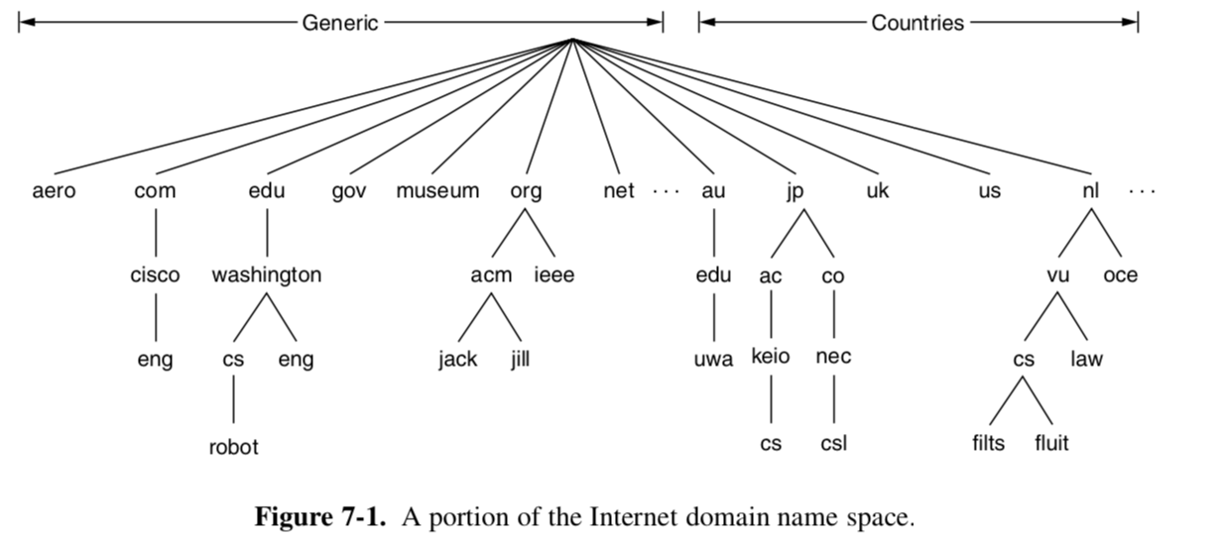
DNS (Domain Name System)
The top of the naming hierarchy is managed by an organization called ICANN (Internet Corporation for Assigned Names and Numbers)
250 top-level domains

Slide 5



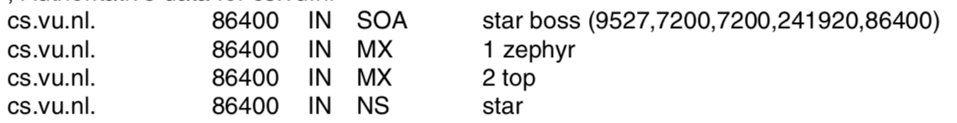
Domain Resource Records
Every domain, whether it is a single host or a top level domain, can have a set of resource records associated with it. These records are the DNS database.
what kind of record this is
The format of a resource record
This field can be a number, a domain name, or an ASCII string. The semantics depend on the record type.
how stable the record is
IN: Internet information
Notes:
Time to live gives an indication of how stable the record is. If the value is large, which means this record is very stable.
Class, For Internet information, it is always IN. For non-Internet information, other codes can be used, but in practice these are rarely seen.
The Type field tells what kind of record this is. There are many kinds of DNS records.

Slide 6
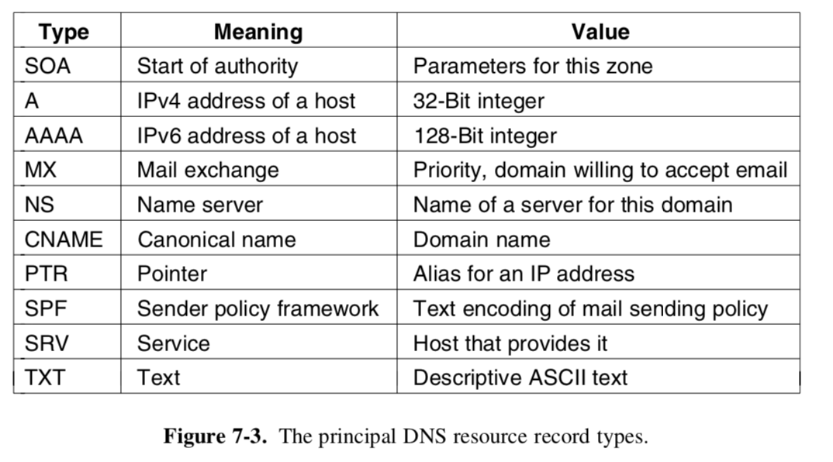
Type of a record

Slide 7
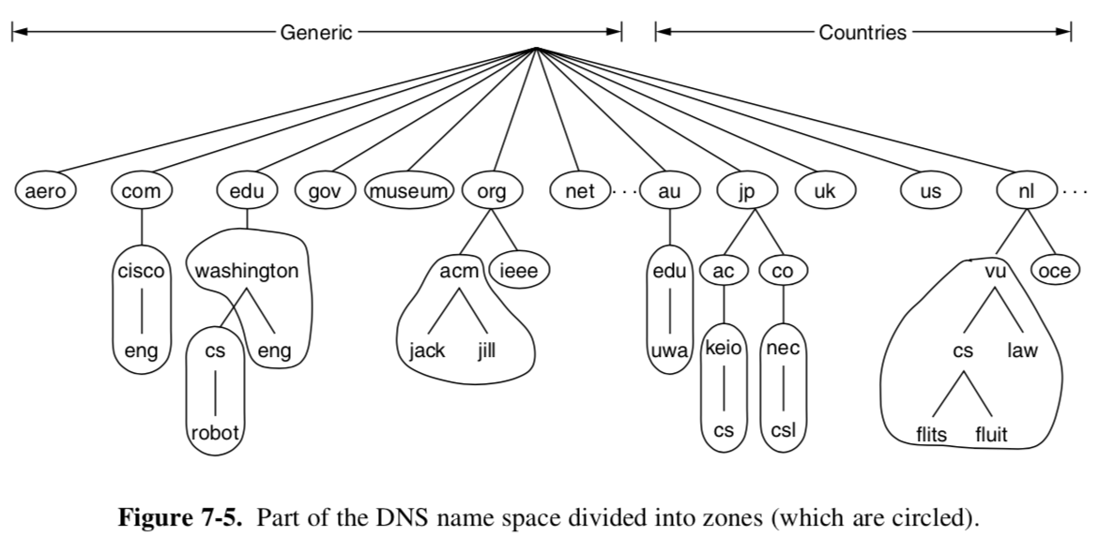
A very large, single name server, which contains the entire DNS database
Disadvantages:
In practice, this server would be so overloaded as to be useless.
Furthermore, if it ever went down, the entire Internet would be crippled.
We should divide the DNS name space into nonoverlapping zones

Slide 8
Name Resolution
The process of looking up a name and finding out an address is called name resolution.
2 types of name servers
Local name server:
The server is located within the zone.
Remote name server:
The server is located outside the zone.

Slide 9
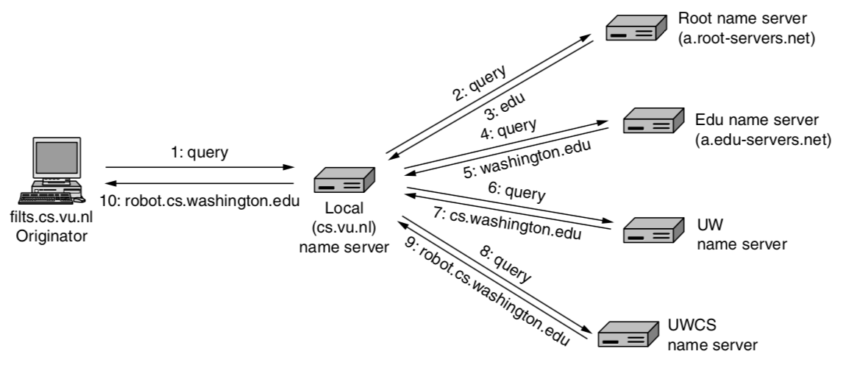
The process of Name Resolution
when flits.cs.vu.nl wants to find the IP address of robot.cs.washington.edu
top.cs.vn.nl
robot.cs.washington.edu

Slide 10
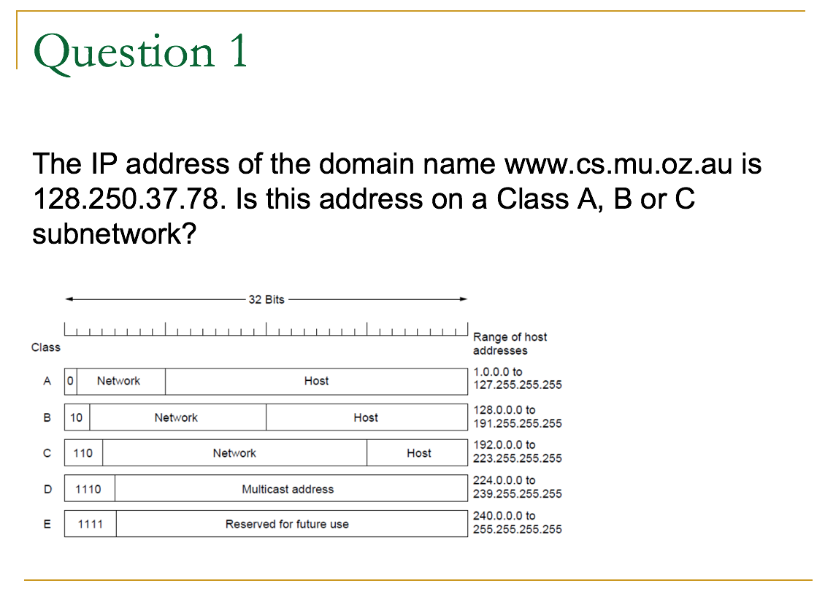
10000000.11111010.00100101.01001110
Answer:
The first byte of the address is 128 (decimal), or 10000000 in binary. An IP address with a leading 10 corresponds to a Class B subnetwork.

Slide 11
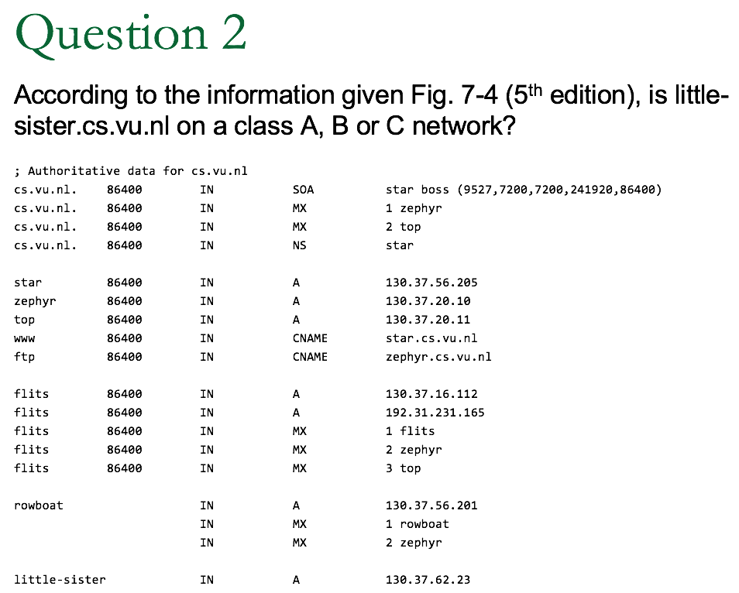
Answer:
It’s IP address starts with 130, so it is on a class B network.

Slide 12
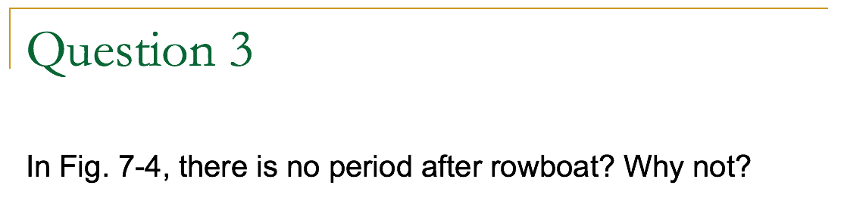
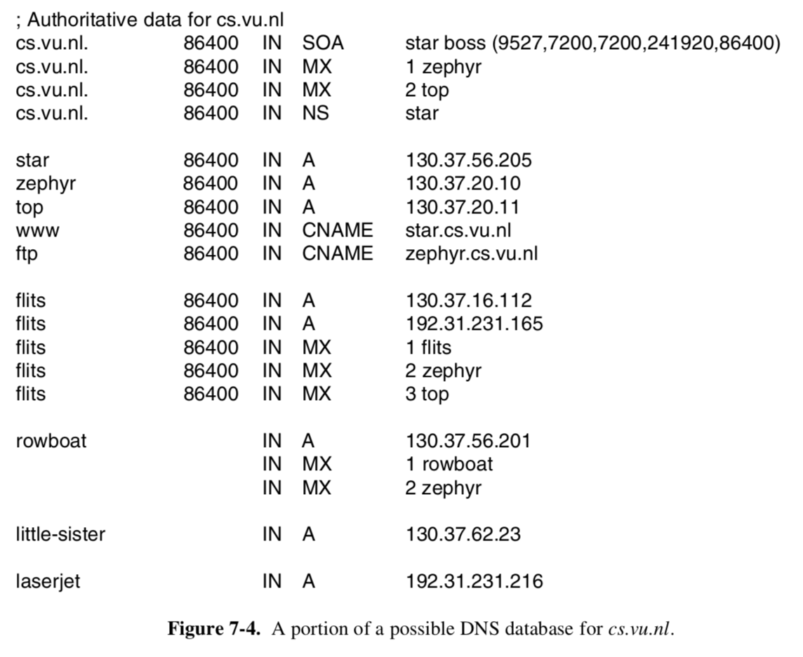
Answer:
It is not an absolute name, but relative to .cs.vu.nl.
It is really just shorthand notation for rowboat.cs.vu.nl

Slide 13
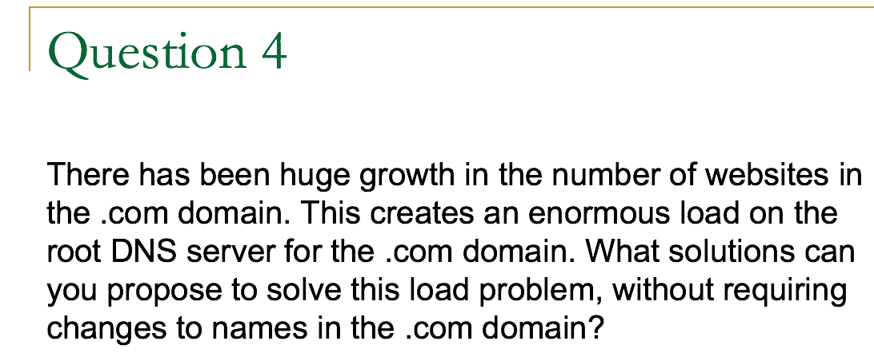
Answer:
One option is to route queries to different root servers based on the first letter of the domain name, e.g., google.com is mapped to root server G, etc.

Slide 14
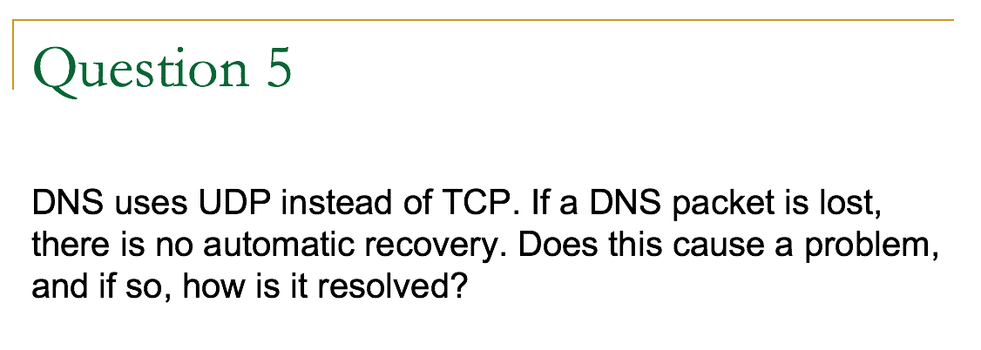
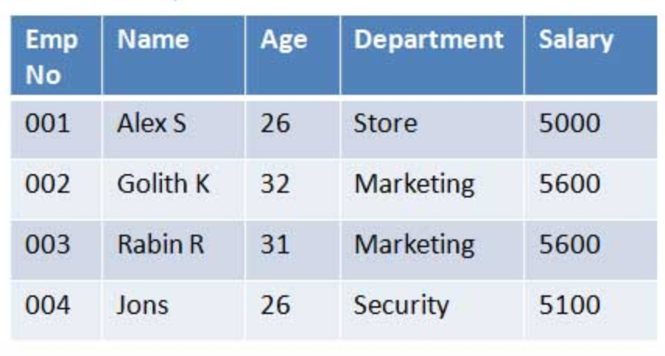
Operation:
Delete the row which Emp No is 004
What will happen if I do this operation several times?
We just delete that row once, no matter how many times u do this operation, the result doesn't change.
idempotent

Slide 15
Answer:
Just like delete, DNS is idempotent (operations can be repeated without changing the final result),
When a process makes a DNS request, it starts a timer. If the timer expires, it just makes the request again. No harm is done.

Slide 16
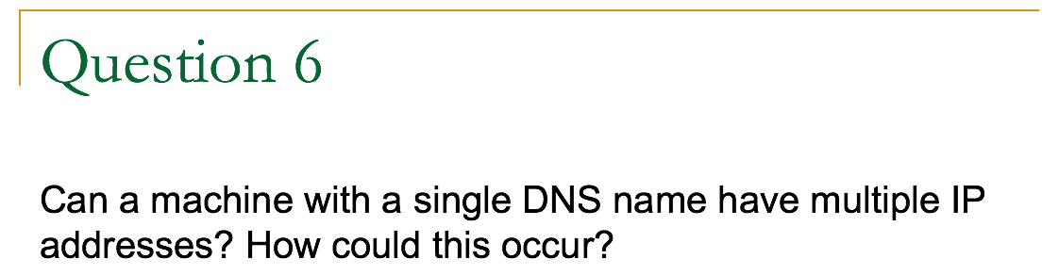
Answer:
Yes. In fact, in Fig. 7-4 we see an example of a duplicate IP address.
Remember that an IP address consists of a network part and a host part. If a machine has two Ethernet cards(also now as NIC(Network interface card)), it can be on two separate networks, and if so, it needs two IP addresses.

Slide 17
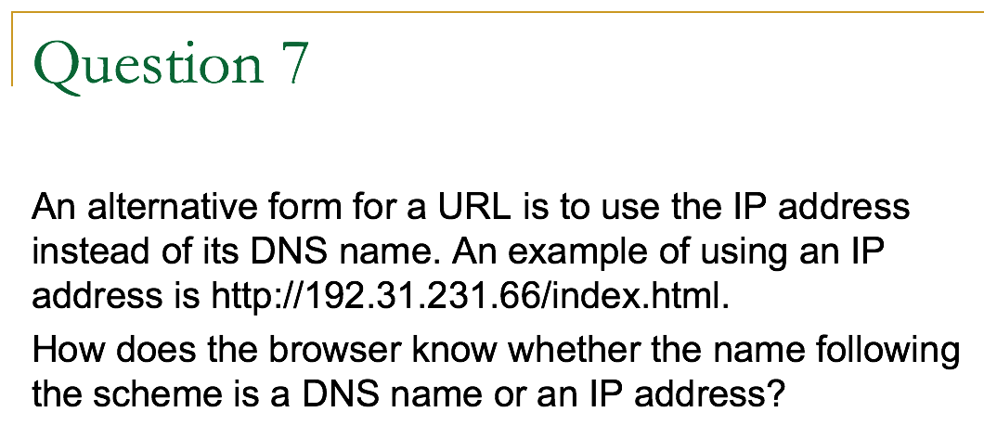
Answer:
DNS names may not end with a digit, so there is no ambiguity.

Slide 18
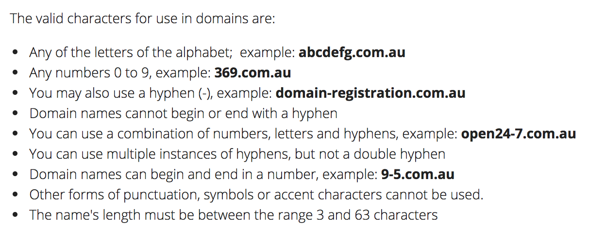
888888.com

Slide 19
Last week

Slide 20
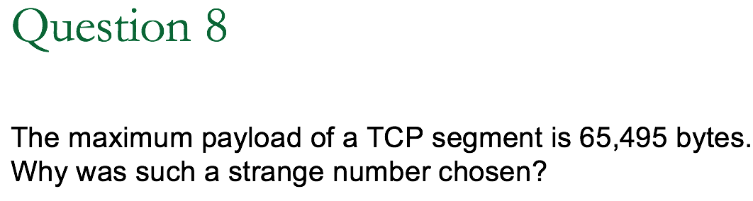
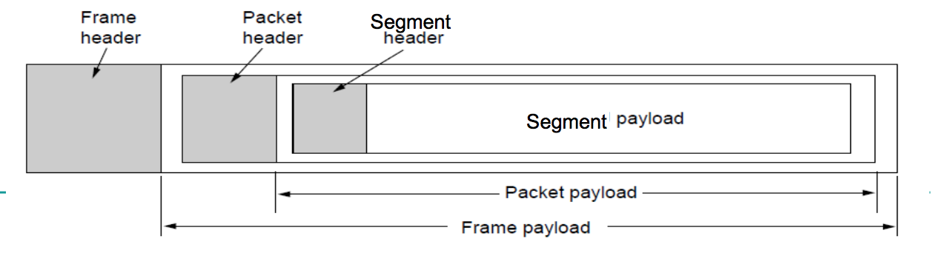
Segment payload = frame payload – packet header – segment header
IP packet length
(includes header and payload)
65535 bytes

Slide 21

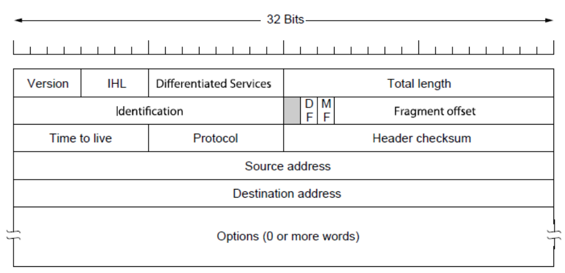
Minimum IP packet header =
5 * 4 = 20bytes

Slide 22
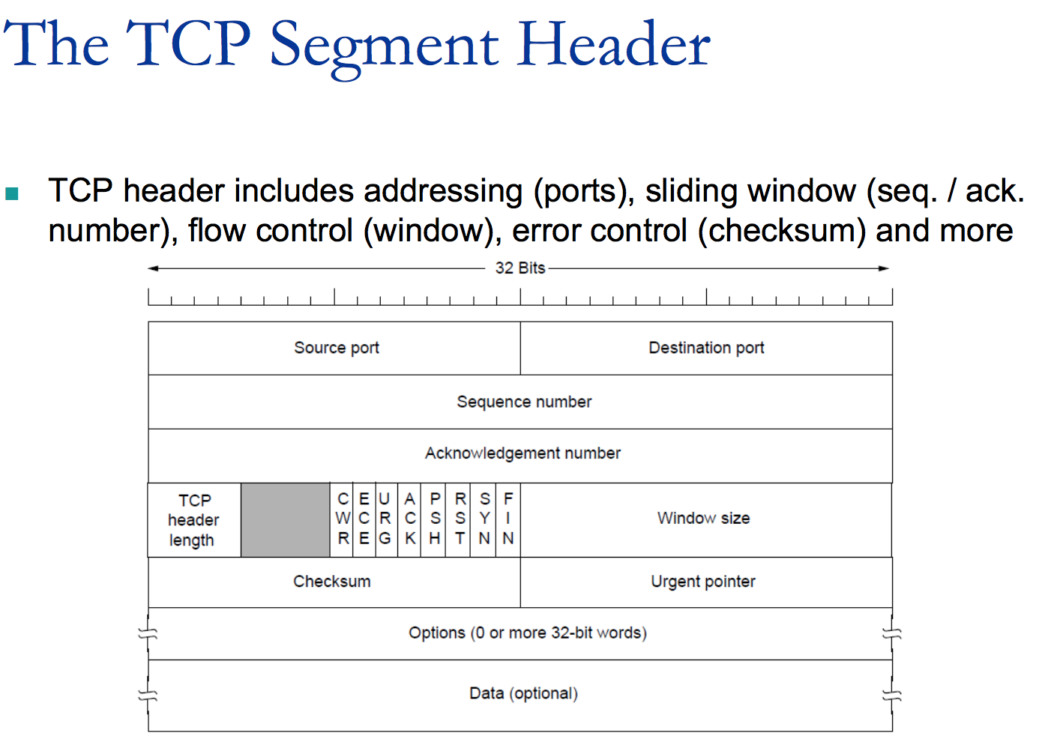
Minimum TCP segment header =
5 * 4 = 20bytes

Slide 23
Segment payload = frame payload – packet header – segment header
= 65495 bytes
20 bytes
20 bytes
IP packet length
(includes header and payload)
65535 bytes

Slide 24
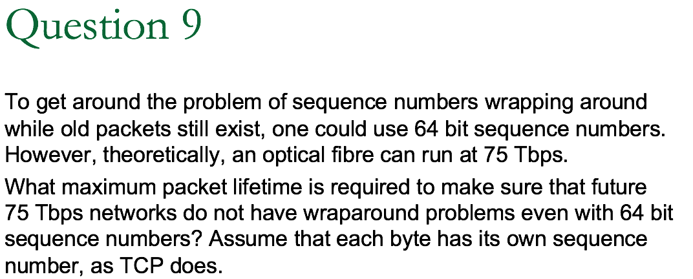
1 Tbps = 10¹²bps = 1.25*10¹¹ bytes/second
Answer:
The sequence space is 2⁶⁴. Each byte is assigned a unique sequence number, so the sequence numbers can represent 2⁶⁴ unique bytes.
A 75 Tbps transmitter can output 9.375×10¹² bytes/s.
t = 2⁶⁴ / 9.375×10¹² = 1.96×10⁶ s = 22.77 days
It takes 22.77 days, which is over three weeks, to wrap around. A maximum packet lifetime of less than 22.77 days will prevent the problem. In short, going to 64 bits is going to work for quite a while.

